Slide 1

The Machine Learning Process
How do I create dummy variables
in pandas?
Dr. Reza Dibaj

Slide 2
Creating dummy variables
Dummy variables or indicator variables: Imagine for a column, named gender we use 0 for Female and 1 for Male.
This process is also used to include unordered categorical features in ML models.

Slide 3
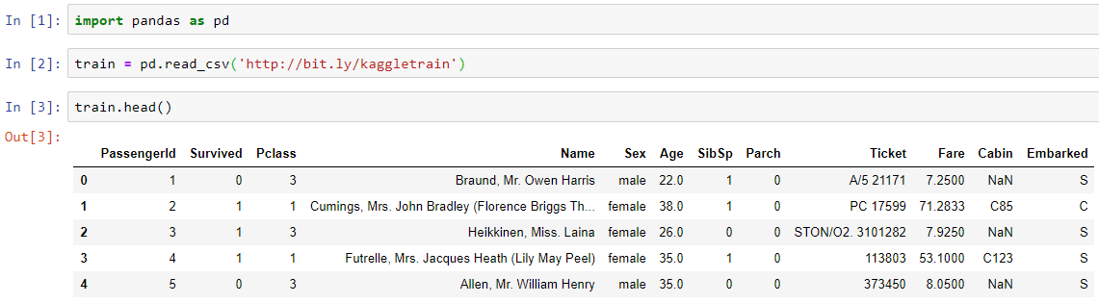
Creating dummy variables
Let’s pull up an example dataset as follows:
Notes:
import pandas as pd
train = pd.read_csv('http://bit.ly/kaggletrain’)
train.head()

Slide 4
Creating dummy variables
Suppose we want to create dummy variable for the Sex column:

Slide 5
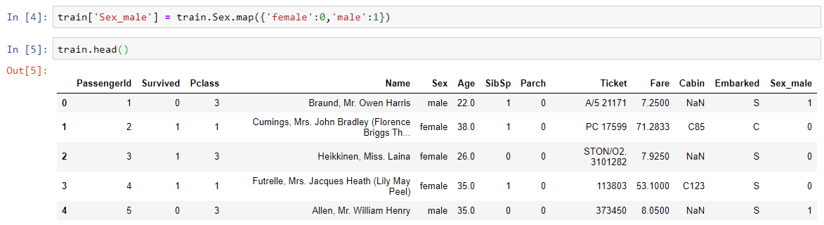
Creating dummy variables
One way is to use Series map() method, creating a new Series for the current DF and using a dictionary as follows:
Notes:
train['Sex_male'] = train.Sex.map({'female':0,'male':1})
train.head()

Slide 6
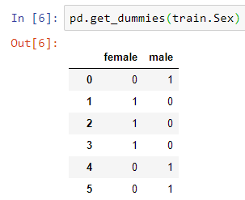
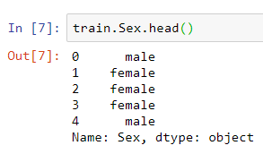
Creating dummy variables
Another way is using a top-level function which is more flexible.
Notes:
pd.get_dummies(train.Sex)
train.Sex.head()

Slide 7
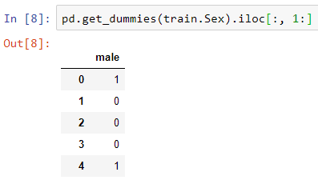
Creating dummy variables
So, now we can simply consider only the male column as follows:
Does it work with loc()?
Notes:
pd.get_dummies(train.Sex).iloc[:, 1:]

Slide 8
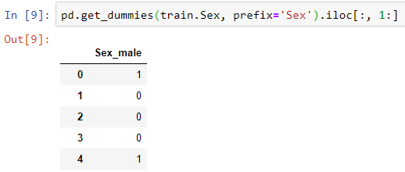
Creating dummy variables
If we identify the original column that the dummy variable was derived from, the result would be as follows:
It is exactly similar to what we received by using the dictionary method.
Notes:
pd.get_dummies(train.Sex, prefix='Sex').iloc[:, 1:]

Slide 9
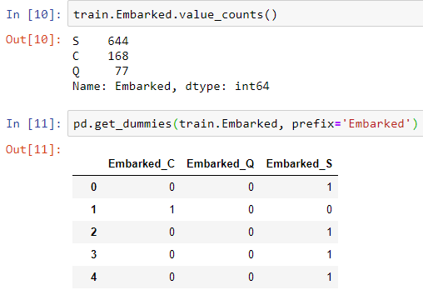

Creating dummy variables
Let’s see why the second method is more flexible:
Imagine we want to wok on Embarked which has 3 different values:
Notes:
train.Embarked.value_counts()
pd.get_dummies(train.Embarked, prefix='Embarked')

Slide 10

Creating dummy variables
Rule of thumb: If we have k variables, we need k-1 dummy variables to capture all possibilities.

Slide 11
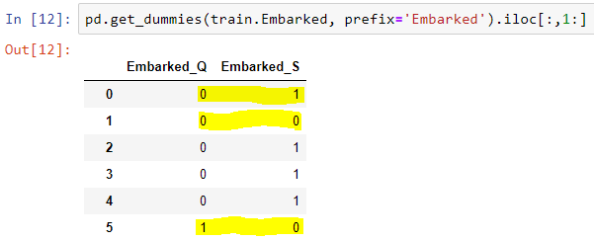
Creating dummy variables
So, we include all the rows and column one through the end:
Technically, we dropped the C column and stablished it as the base line.
So if it is 0,1 it is S, and if it is 1,0, it is Q and if it is 0,0, it is C.
S
C
Q
Notes:
pd.get_dummies(train.Embarked, prefix='Embarked').iloc[:,1:]

Slide 12
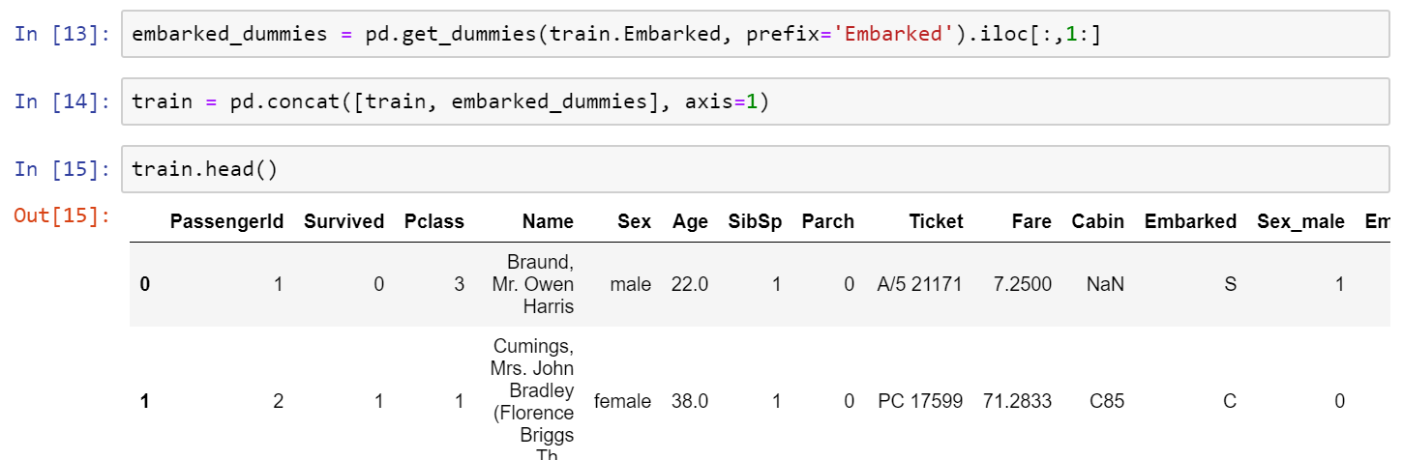
Creating dummy variables
The question is how could we attach this to the DF?
Notes:
embarked_dummies = pd.get_dummies(train.Embarked, prefix='Embarked').iloc[:,1:]
train = pd.concat([train, embarked_dummies], axis=1)
train.head()

Slide 13

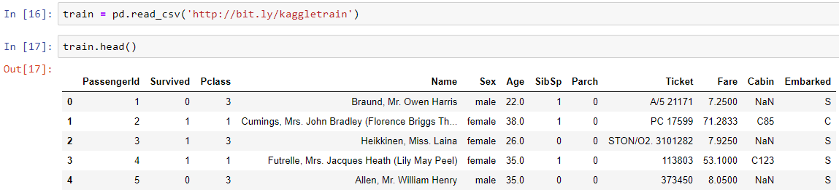
Bonus Tip
For the bonus tip, we need to reset the DF as follows:
Notes:
train = pd.read_csv('http://bit.ly/kaggletrain’)
train.head()

Slide 14
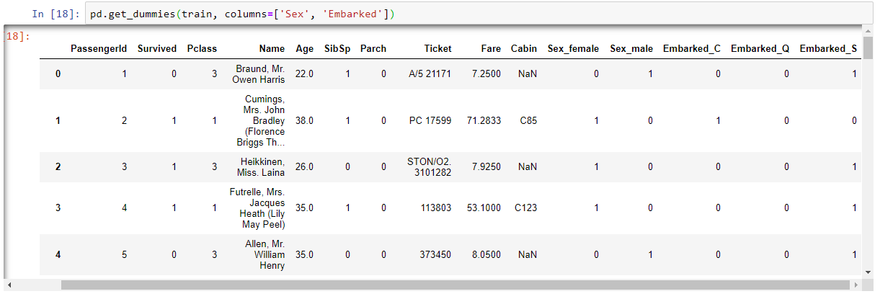
Bonus Tip
Instead of passing a Series to pd.get_dummies, a trick is how to pass a DF to pd.get_dummies:
Isn’t it COOL? The original Sex and Embarked columns are gone and replaced with the dummy columns.
Notes:
pd.get_dummies(train, columns=['Sex', 'Embarked'])

Slide 15
Bonus Tip
And if you like to make it similar to our previous example, you can drop Sex_female and Embarked_C columns.

Slide 16
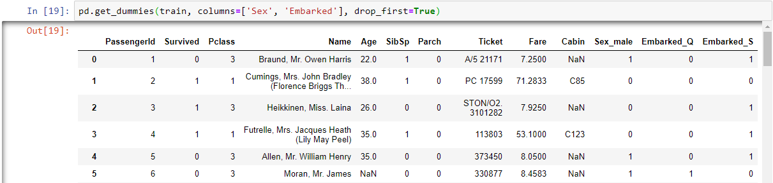
Bonus Tip 4 The Bonus Tip
In recent versions they added a cool feature that resolve the previous problem and we do not need to manually delete the Sex_female and Embarked_C columns:
Notes:
pd.get_dummies(train, columns=['Sex', 'Embarked'], drop_first=True)

Slide 17

Thank you
Question?
To be
Not to be

